Slide 1
Cryptography and Network Security
ADVANCED ENCRYPTION STANDARD

Slide 2
Session Meta Data
Author | Dr T Sree Sharmila
Reviewer
Version Number | 1.0
Release Date | 4 July 2018

Slide 3
Revision History
Revision Date | Details | Version no.
 |  | 1.0

Slide 4
Agenda
Introduction
Origin
AES requirement
AES evaluation criteria
AES Shortlist
AES
Substitute bytes
Shift rows
Mixing columns
Add round key
Decryption
Summary
Test your understanding
References

Slide 5
Introduction
AES Selection process
AES Encryption & Decryption details
Details of every round structure
Substitute bytes
Shift rows
Mixing columns
Add round key
Implementation Aspects

Slide 6
Agenda
Introduction
Origin
AES requirement
AES evaluation criteria
AES Shortlist
AES
Substitute bytes
Shift rows
Mixing columns
Add round key
Decryption
Summary
Test your understanding
References

Slide 7
Origin
clear a replacement for DES was needed
have theoretical attacks that can break it
have demonstrated exhaustive key search attacks
can use Triple-DES – but slow, has small blocks
US NIST issued call for ciphers in 1997
15 candidates accepted in Jun 98
5 were shortlisted in Aug-99
Rijndael was selected as the AES in Oct-2000
issued as FIPS PUB 197 standard in Nov-2001
Notes:
The Advanced Encryption Standard (AES) was published by NIST (National Institute of Standards and Technology) in 2001. AES is a symmetric block cipher that is intended to replace DES as the approved standard for a wide range of applications. The AES cipher (& other candidates) form the latest generation of block ciphers, and now we see a significant increase in the block size - from the old standard of 64-bits up to 128-bits; and keys from 128 to 256-bits. In part this has been driven by the public demonstrations of exhaustive key searches of DES. Whilst triple-DES is regarded as secure and well understood, it is slow, especially in s/w. In a first round of evaluation, 15 proposed algorithms were accepted. A second round narrowed the field to 5 algorithms. NIST completed its evaluation process and published a final standard (FIPS PUB 197) in November of 2001. NIST selected Rijndael as the proposed AES algorithm. The two researchers who developed and submitted Rijndael for the AES are both cryptographers from Belgium: Dr. Joan Daemen and Dr.Vincent Rijmen.

Slide 8
Agenda
Introduction
Origin
AES requirement
AES evaluation criteria
AES Shortlist
AES
Substitute bytes
Shift rows
Mixing columns
Add round key
Decryption
Summary
Test your understanding
References

Slide 9
AES Requirements
private key symmetric block cipher
128-bit data, 128/192/256-bit keys
stronger & faster than Triple-DES
active life of 20-30 years (+ archival use)
provide full specification & design details
both C & Java implementations
NIST have released all submissions & unclassified analyses
Notes:
Listed above are NIST’s requirements for the AES candidate submissions. These criteria span the range of concerns for the practical application of modern symmetric block ciphers.

Slide 10
Agenda
Introduction
Origin
AES requirement
AES evaluation criteria
AES Shortlist
AES
Substitute bytes
Shift rows
Mixing columns
Add round key
Decryption
Summary
Test your understanding
References

Slide 11
AES Evaluation Criteria
initial criteria:
security – effort for practical cryptanalysis
cost – in terms of computational efficiency
algorithm & implementation characteristics
final criteria
general security
ease of software & hardware implementation
implementation attacks
flexibility (in en/decrypt, keying, other factors)
Notes:
In fact, two set of criteria evolved. When NIST issued its original request for candidate algorithm nominations in 1997, the request stated that candidate algorithms would be compared based on the factors shown in Stallings Table5.1, which were used to evaluate field of 15 candidates to select shortlist of 5. These had categories of security, cost, and algorithm & implementation characteristics.
The final criteria evolved during the evaluation process, and were used to select Rijndael from that short-list, and more details are given in Stallings Table 5.2, with categories of: general security, ease of software & hardware implementation, implementation attacks, & flexibility (in en/decrypt, keying, other factors).

Slide 12
Agenda
Introduction
Origin
AES requirement
AES evaluation criteria
AES Shortlist
AES
Substitute bytes
Shift rows
Mixing columns
Add round key
Decryption
Summary
Test your understanding
References

Slide 13
AES Shortlist
after testing and evaluation, shortlist in Aug-99:
MARS (IBM) - complex, fast, high security margin
RC6 (USA) - v. simple, v. fast, low security margin
Rijndael (Belgium) - clean, fast, good security margin
Serpent (Euro) - slow, clean, v. high security margin
Twofish (USA) - complex, v. fast, high security margin
then subject to further analysis & comment
saw contrast between algorithms with
few complex rounds verses many simple rounds
which refined existing ciphers verses new proposals
Notes:
The AES shortlist of 5 ciphers was as shown. Note mix of commercial (MARS, RC6, Twofish) verses academic (Rijndael, Serpent) proposals, sourced from various countries.
All were thought to be good – it came down to the best balance of attributes to meet criteria, in particular the balance between speed, security & flexibility.

Slide 14
Agenda
Introduction
Origin
AES requirement
AES evaluation criteria
AES Shortlist
AES
Substitute bytes
Shift rows
Mixing columns
Add round key
Decryption
Summary
Test your understanding
References

Slide 15
The AES Cipher - Rijndael
designed by Rijmen-Daemen in Belgium
has 128/192/256 bit keys, 128 bit data
an iterative rather than feistel cipher
processes data as block of 4 columns of 4 bytes
operates on entire data block in every round
designed to be:
resistant against known attacks
speed and code compactness on many CPUs
design simplicity
Notes:
The Rijndael proposal for AES defined a cipher in which the block length and the key length can be independently specified to be 128,192,or 256 bits. The AES specification uses the same three key size alternatives but limits the block length to 128 bits. Rijndael is an academic submission, based on the earlier Square cipher, from Belgium academics Dr Joan Daemen and Dr Vincent Rijmen. It is an iterative cipher (operates on entire data block in every round) rather than feistel (operate on halves at a time), and was designed to have characteristics of: Resistance against all known attacks, Speed and code compactness on a wide range of platforms, & Design simplicity.

Slide 16
Rijndael
data block of 4 columns of 4 bytes is state
key is expanded to array of words
has 9/11/13 rounds in which state undergoes:
byte substitution (1 S-box used on every byte)
shift rows (permute bytes between groups/columns)
mix columns (subs using matrix multipy of groups)
add round key (XOR state with key material)
view as alternating XOR key & scramble data bytes
initial XOR key material & incomplete last round
with fast XOR & table lookup implementation
Notes:
The input to the AES encryption and decryption algorithms is a single 128-bit block, depicted in FIPS PUB 197, as a square matrix of bytes .This block is copied into the State array, which is modified at each stage of encryption or decryption. After the final stage, State is copied to an output.
The key is expanded into 44/52/60 lots of 32-bit words (see later), with 4 used in each round.
The data computation then consists of an “add round key” step, then 9/11/13 rounds with all 4 steps, and a final 10th/12th/14th step of byte subs + mix cols + add round key. This can be viewed as alternating XOR key & scramble data bytes operations. All of the steps are easily reversed, and can be efficiently implemented using XOR’s & table lookups.

Slide 17
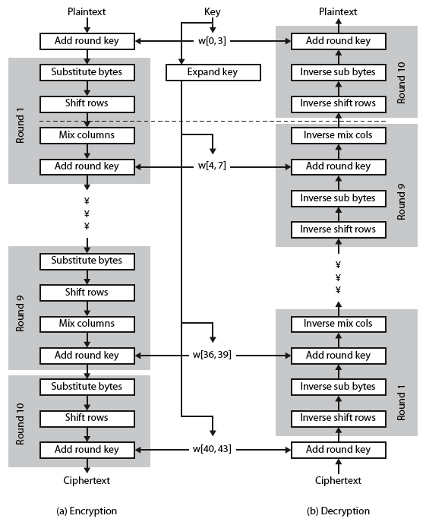
Rijndael
Notes:
Stallings Figure 5.1 shows the overall structure of AES, as detailed on the previous slide.

Slide 18
Agenda
Introduction
Origin
AES requirement
AES evaluation criteria
AES Shortlist
AES
Substitute bytes
Shift rows
Mixing columns
Add round key
Decryption
Summary
Test your understanding
References

Slide 19
Byte Substitution
a simple substitution of each byte
uses one table of 16x16 bytes containing a permutation of all 256 8-bit values
each byte of state is replaced by byte indexed by row (left 4-bits) & column (right 4-bits)
eg. byte {95} is replaced by byte in row 9 column 5
which has value {2A}
S-box constructed using defined transformation of values in GF(2⁸)
designed to be resistant to all known attacks
Notes:
Now discuss each of the four stages used in AES. The Substitute bytes stage uses an S-box to perform a byte-by-byte substitution of the block. There is a single 8-bit wide S-box used on every byte. This S-box is a permutation of all 256 8-bit values, constructed using a transformation which treats the values as polynomials in GF(2⁸) – however it is fixed, so really only need to know the table when implementing. Decryption requires the inverse of the table. These tables are given in Stallings Table 4.5.
The table was designed to be resistant to known cryptanalytic attacks. Specifically, the Rijndael developers sought a design that has a low correlation between input bits and output bits, with the property that the output cannot be described as a simple mathematical function of the input, with no fixed points and no “opposite fixed points”.

Slide 20
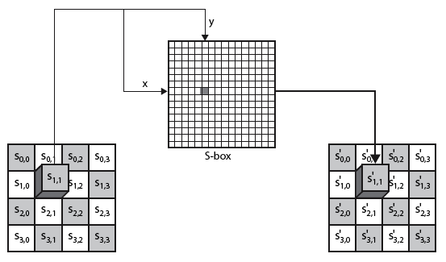
Byte Substitution
Notes:
As this diagram from Stallings Fig 5.4a shows, the Byte Substitution operates on each byte of state independently, with the input byte used to index a row/col in the table to retrieve the substituted value.

Slide 21
Agenda
Introduction
Origin
AES requirement
AES evaluation criteria
AES Shortlist
AES
Substitute bytes
Shift rows
Mixing columns
Add round key
Decryption
Summary
Test your understanding
References

Slide 22
Shift Rows
a circular byte shift in each each
1st row is unchanged
2nd row does 1 byte circular shift to left
3rd row does 2 byte circular shift to left
4th row does 3 byte circular shift to left
decrypt inverts using shifts to right
since state is processed by columns, this step permutes bytes between the columns
Notes:
The ShiftRows stage provides a simple “permutation” of the data, whereas the other steps involve substitutions. Further, since the state is treated as a block of columns, it is this step which provides for diffusion of values between columns. It performs a circular rotate on each row of 0, 1, 2 & 3 places for respective rows. When decrypting it performs the circular shifts in the opposite direction for each row. This row shift moves an individual byte from one column to another, which is a linear distance of a multiple of 4 bytes, and ensures that the 4 bytes of one column are spread out to four different columns.

Slide 23
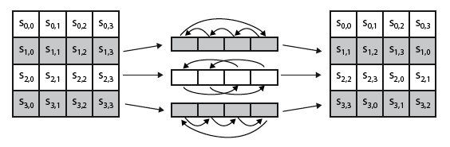
Shift Rows
Notes:
Stalling Figure 5.5a illustrates the Shift Rows permutation.

Slide 24
Agenda
Introduction
Origin
AES requirement
AES evaluation criteria
AES Shortlist
AES
Substitute bytes
Shift rows
Mixing columns
Add round key
Decryption
Summary
Test your understanding
References

Slide 25

Mix Columns
each column is processed separately
each byte is replaced by a value dependent on all 4 bytes in the column
effectively a matrix multiplication in GF(2⁸) using prime poly m(x) =x⁸+x⁴+x³+x+1
Notes:
The MixColumns stage is a substitution that makes use of arithmetic over GF(2^8). Each byte of a column is mapped into a new value that is a function of all four bytes in that column. It is designed as a matrix multiplication where each byte is treated as a polynomial in GF(2⁸). The inverse used for decryption involves a different set of constants.
The constants used are based on a linear code with maximal distance between code words – this gives good mixing of the bytes within each column. Combined with the “shift rows” step provides good avalanche, so that within a few rounds, all output bits depend on all input bits.

Slide 26
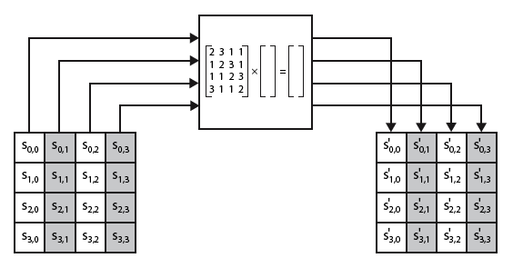
Mix Columns
Notes:
Stalling Figure 5.5b illustrates the Mix Columns transformation.

Slide 27
Mix Columns
can express each col as 4 equations
to derive each new byte in col
decryption requires use of inverse matrix
with larger coefficients, hence a little harder
have an alternate characterisation
each column a 4-term polynomial
with coefficients in GF(2⁸)
and polynomials multiplied modulo (x⁴+1)
Notes:
In practise, you implement Mix Columns by expressing the transformation on each column as 4 equations (Stallings equation 5.4) to compute the new bytes for that column. This computation only involves shifts, XORs & conditional XORs (for the modulo reduction).
The decryption computation requires the use of the inverse of the matrix, which has larger coefficients, and is thus potentially a little harder & slower to implement.
The designers & the AES standard provide an alternate characterisation of Mix Columns, which treats each column of State to be a four-term polynomial with coefficients in GF(2⁸). Each column is multiplied by a fixed polynomial a(x) given in Stallings eqn 5.7. Whilst this is useful for analysis of the stage, the matrix description is all that’s required for implementation.

Slide 28
Agenda
Introduction
Origin
AES requirement
AES evaluation criteria
AES Shortlist
AES
Substitute bytes
Shift rows
Mixing columns
Add round key
Decryption
Summary
Test your understanding
References

Slide 29
Add Round Key
XOR state with 128-bits of the round key
again processed by column (though effectively a series of byte operations)
inverse for decryption identical
since XOR own inverse, with reversed keys
designed to be as simple as possible
a form of Vernam cipher on expanded key
requires other stages for complexity / security
Notes:
Lastly is the Add Round Key stage which is a simple bitwise XOR of the current block with a portion of the expanded key. Note this is the only step which makes use of the key and obscures the result, hence MUST be used at start and end of each round, since otherwise could undo effect of other steps. But the other steps provide confusion/diffusion/non-linearity. That us you can look at the cipher as a series of XOR with key then scramble/permute block repeated. This is efficient and highly secure it is believed.

Slide 30
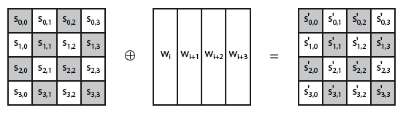
Add Round Key
Notes:
Stallings Figure 5.4b illustrates the Add Round Key stage, which like Byte Substitution, operates on each byte of state independently.

Slide 31
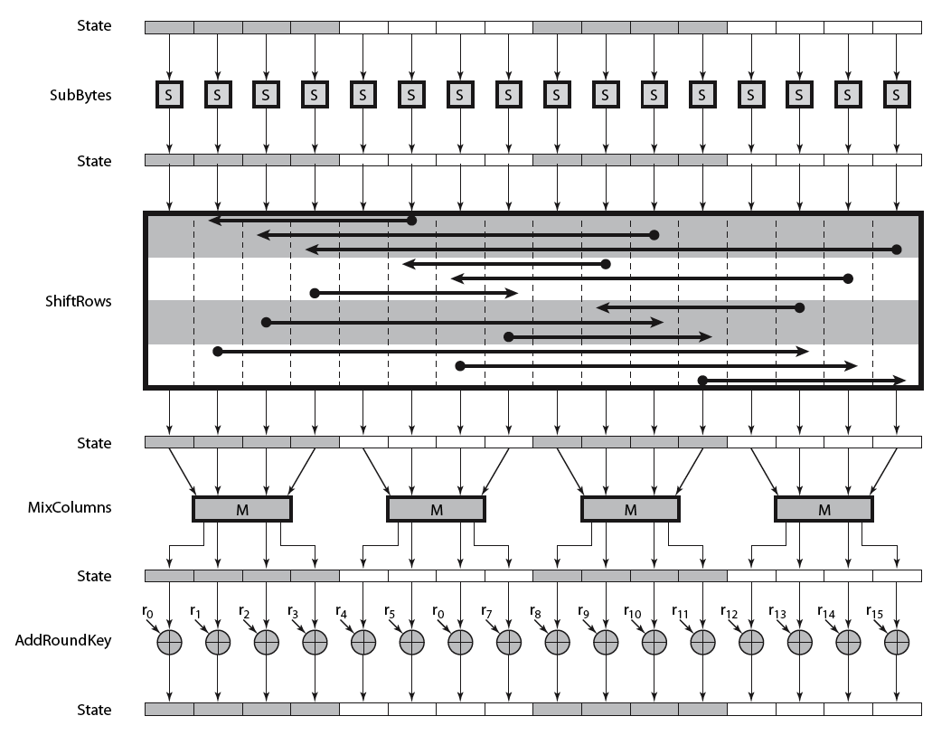
AES Round
Notes:
Can thus now view all the internal details of the AES round, showing how each byte of the state is manipulated, as shown in Stallings Figure 5.3.

Slide 32
AES Key Expansion
takes 128-bit (16-byte) key and expands into array of 44/52/60 32-bit words
start by copying key into first 4 words
then loop creating words that depend on values in previous & 4 places back
in 3 of 4 cases just XOR these together
1st word in 4 has rotate + S-box + XOR round constant on previous, before XOR 4th back
Notes:
The AES key expansion algorithm takes as input a 4-word (16-byte) key and produces a linear array of words, providing a 4-word round key for the initial AddRoundKey stage and each of the 10/12/14 rounds of the cipher. It involves copying the key into the first group of 4 words, and then constructing subsequent groups of 4 based on the values of the previous & 4th back words. The first word in each group of 4 gets “special treatment” with rotate + S-box + XOR constant on the previous word before XOR’ing the one from 4 back. In the 256-bit key/14 round version, there’s also an extra step on the middle word.

Slide 33
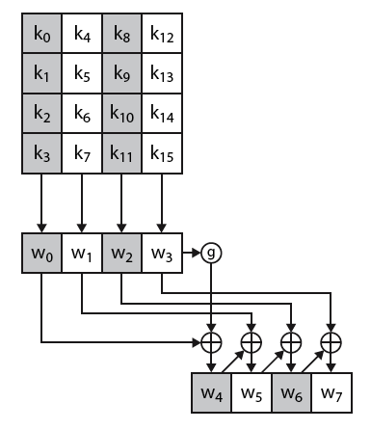
AES Key Expansion
Notes:
The first block of the AES Key Expansion is shown here in Stallings Figure 5.6. It shows each group of 4 bytes in the key being assigned to the first 4 words, then the calculation of the next 4 words based on the values of the previous 4 words, which is repeated enough times to create all the necessary subkey information.

Slide 34
Key Expansion Rationale
designed to resist known attacks
design criteria included
knowing part key insufficient to find many more
invertible transformation
fast on wide range of CPU’s
use round constants to break symmetry
diffuse key bits into round keys
enough non-linearity to hinder analysis
simplicity of description
Notes:
The Rijndael developers designed the expansion key algorithm to be resistant to known cryptanalytic attacks. It is designed to be simple to implement, but by using round constants break symmetries, and make it much harder to deduce other key bits if just some are known (but once have as many consecutive bits as are in key, can then easily recreate the full expansion). The design criteria used are listed above.

Slide 35
Agenda
Introduction
Origin
AES requirement
AES evaluation criteria
AES Shortlist
AES
Substitute bytes
Shift rows
Mixing columns
Add round key
Decryption
Summary
Test your understanding
References

Slide 36
AES Decryption
AES decryption is not identical to encryption since steps done in reverse
but can define an equivalent inverse cipher with steps as for encryption
but using inverses of each step
with a different key schedule
works since result is unchanged when
swap byte substitution & shift rows
swap mix columns & add (tweaked) round key
Notes:
The AES decryption cipher is not identical to the encryption cipher (Stallings Figure 5.1). The sequence of transformations for decryption differs from that for encryption, although the form of the key schedules for encryption and decryption is the same. This has the disadvantage that two separate software or firmware modules are needed for applications that require both encryption and decryption. There is, however, an equivalent version of the decryption algorithm that has the same structure as the encryption algorithm, with the same sequence of transformations as the encryption algorithm (with transformations replaced by their inverses). To achieve this equivalence,a change in key schedule is needed.
By constructing an equivalent inverse cipher with steps in same order as for encryption, we can derive a more efficient implementation. Clearly swapping the byte substitutions and shift rows has no effect, since work just on bytes. Swapping the mix columns and add round key steps requires the inverse mix columns step be applied to the round keys first – this makes the decryption key schedule a little more complex with this construction, but allows the use of same h/w or s/w for the data en/decrypt computation.

Slide 37
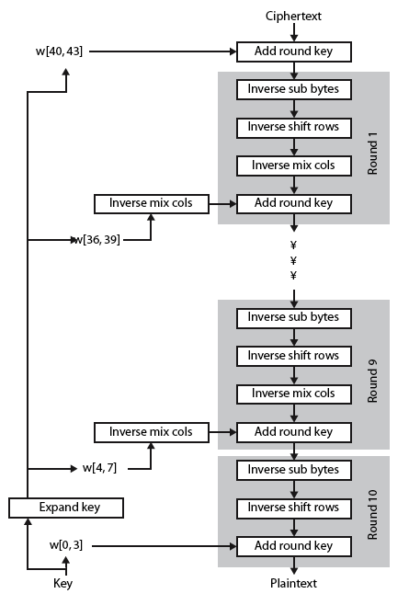
AES Decryption
Notes:
Illustrate the equivalent inverse cipher with Stallings Figure 5.7.

Slide 38
Implementation Aspects
can efficiently implement on 8-bit CPU
byte substitution works on bytes using a table of 256 entries
shift rows is simple byte shift
add round key works on byte XOR’s
mix columns requires matrix multiply in GF(2⁸) which works on byte values, can be simplified to use table lookups & byte XOR’s
Notes:
AES can be implemented very efficiently on an 8-bit processor.
AddRoundKey is a bytewise XOR operation.
ShiftRows is a simple byte shifting operation.
SubBytes operates at the byte level and only requires a lookup of a 256 byte table S.
MixColumns (matrix multiply) can be implemented as byte XOR’s & table lookups with a 2nd 256 byte table X2, using the formulae shown in Stallings equation 5.9.

Slide 39
Implementation Aspects
can efficiently implement on 32-bit CPU
redefine steps to use 32-bit words
can precompute 4 tables of 256-words
then each column in each round can be computed using 4 table lookups + 4 XORs
at a cost of 4Kb to store tables
designers believe this very efficient implementation was a key factor in its selection as the AES cipher
Notes:
AES can also be very efficiently implemented on an 32-bit processor, by rewriting the stage transformation to use 4 table lookups & 4 XOR’s per column of state. These tables can be computed in advance using the formulae shown in the text, and need 4Kb to store.
The developers of Rijndael believe that this compact, efficient implementation was probably one of the most important factors in the selection of Rijndael for AES.

Slide 40
Agenda
Introduction
Origin
AES requirement
AES evaluation criteria
AES Shortlist
AES
Substitute bytes
Shift rows
Mixing columns
Add round key
Decryption
Summary
Test your understanding
References

Slide 41
Summary
have considered:
the AES selection process
the details of Rijndael – the AES cipher
looked at the steps in each round
the key expansion
implementation aspects
Notes:
Chapter 5 summary.

Slide 42
Agenda
Introduction
Origin
AES requirement
AES evaluation criteria
AES Shortlist
AES
Substitute bytes
Shift rows
Mixing columns
Add round key
Decryption
Summary
Test your understanding
References

Slide 43
Test your understanding
Explain AES algorithm in detail.
What are the basic building blocks of AES cipher.

Slide 44
Agenda
Introduction
Origin
AES requirement
AES evaluation criteria
AES Shortlist
AES
Substitute bytes
Shift rows
Mixing columns
Add round key
Decryption
Summary
Test your understanding
References

Slide 45
References
1. William Stallings, Cryptography and Network Security, 6th Edition, Pearson Education, March 2013.
2. Charlie Kaufman, Radia Perlman and Mike Speciner, “Network Security”, Prentice Hall of India, 2002.

